Slide 1

jQuery Basic
Bok, Jong Soon
javaexpert@nate.com
www.javaexpert.co.kr

Slide 2
Web의 현황
Web Page와 사용자간의 원활한 소통 필요
Web 2.0, Ajax, RWA, RIA
새로운 UX, UI 의 필요
많은 Code, 복잡한 Code, Cross Browsing

Slide 3
JavaScript Library
하나 이상의 Subroutine이나 자주 재 사용 가능한 함수들이 모여 있는 파일.
기능과 UI 가 많아질수록 복잡도가 증가한다.
재 사용될 수 있는 기능들을 라이브러리화 한다.
자주 사용되는 기능들을 모아 놓는다.
Prototype, jQuery, YUI, Dojo, Exit JS, etc.
개발해야 되는 제품의 특성에 따라 사용한다.
직접 만들거나 공개 라이브러리를 사용한다.
효율성(크기, 시간, 기능 등)을 고려한다.

Slide 4
JavaScript Library (Cont.)
특징
Cross Browser Support
Easy Ajax working
DOM 관련 selector, event handler, function support
복잡한 구조를 가진 UI를 손쉽게 구현
UI 구현에 필요한 대부분의 component API 제공

Slide 5
JavaScript Library (Cont.)
장점
이해하기 쉽다
간결한 코드를 구사할 수 있다.
생산성이 향상된다.
중복작업 감소
단점
별도로 library 사용법 학습 및 이해 필요하다.
Size가 큰 file 들을 추가로 load 해야 하는 부담이 있다.

Slide 6


















JavaScript Library (Cont.)
http://hexahost.com/free-js-libraries/

Slide 7
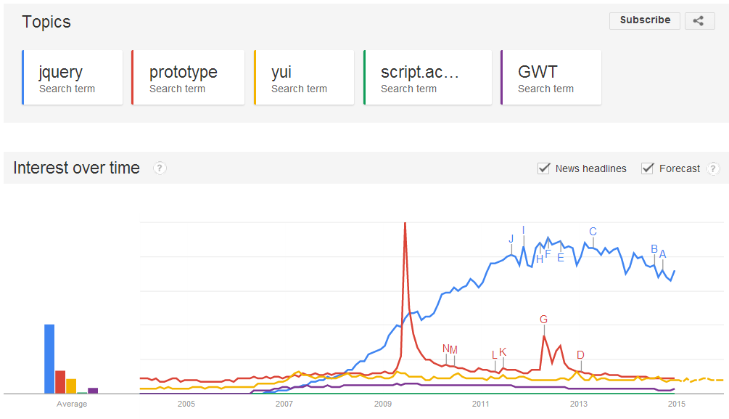
JavaScript Library (Cont.)
http://www.google.com/trends/explore?hl=en-US#q=jquery,%20prototype,%20yui,%20script.aculo.us,%20GWT&cmpt=q

Slide 8

jQuery – http://jquery.com

Slide 9
jQuery (Cont.)
Write less, do more.
2005, John Resig
2006, First Release
문법이 간결하다.
사용하기 쉽다.
빠르게 배울 수 있다.
다른 library 들과 충돌을 일으키지 않는다.
다양한 plug-in 들이 존재한다.
Browser 호환성 문제를 해결해 준다.
MIT & GPL License.

Slide 10
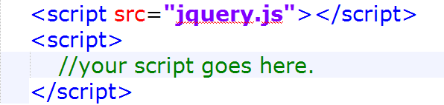
Installation
Downloads script file from jquery.com.
jQuery 1.x vs jQuery 2.x
Compressed vs uncompressed
Downloads js file vs CDN

Slide 11
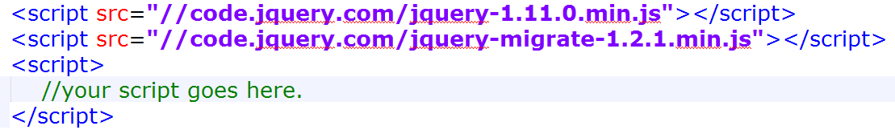
Installation (Cont.)
CDN(Content Delivery Network)
jQuery.com CDN
Google CDN
http://ajax.googleapis.com/ajax/libs/jquery/1.11.1/jquery.min.js
Microsoft CDN
http://ajax.aspnetcdn.com/ajax/jQuery/jquery-1.11.1.js

Slide 12
Recommend Sites
http://api.jquery.com/
http://jqapi.com/
http://www.w3schools.com/jquery/default.asp

Slide 13
Lab : jQuery Installation
Web Browsers
IE11, Firefox, Google Chrome, Opera, Safari
Text Editors
Sublime Text, Notepad++, Editplus
Files
helloworld.html

Slide 14
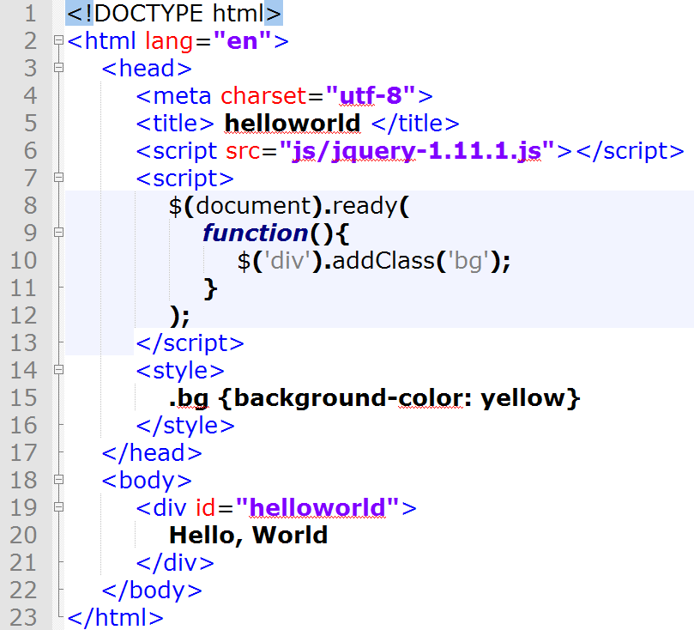
Lab : helloworld.html

Slide 15
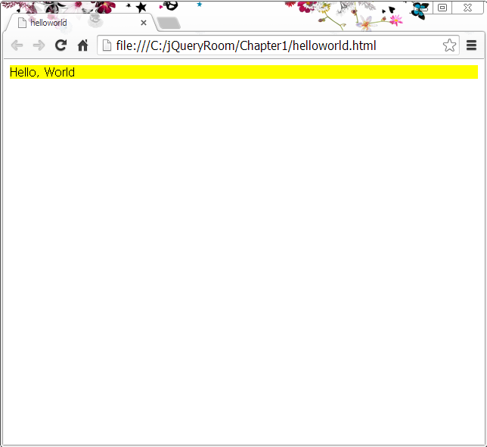
Lab : Result

Slide 16
jQuery’s 9 Categories
Core
Selectors
Attributes/CSS
Manipulation
Traversing
Events
Effects
UI
Ajax

Slide 17
Lab : Simple Code with jQuery
Web Browsers
IE11, Firefox, Google Chrome, Opera, Safari
Text Editors
Sublime Text, Notepad++, Editplus
Files
helloworld1.html

Slide 18
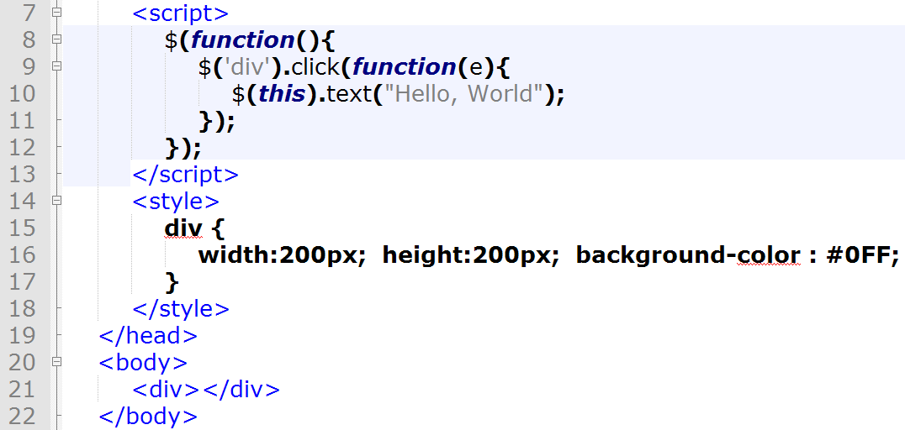
Lab : helloworld1.html

Slide 19
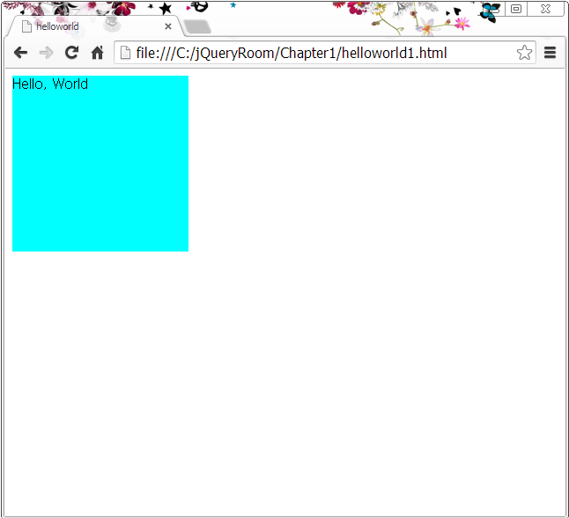
Lab : Result

Slide 20
Core API

Slide 21
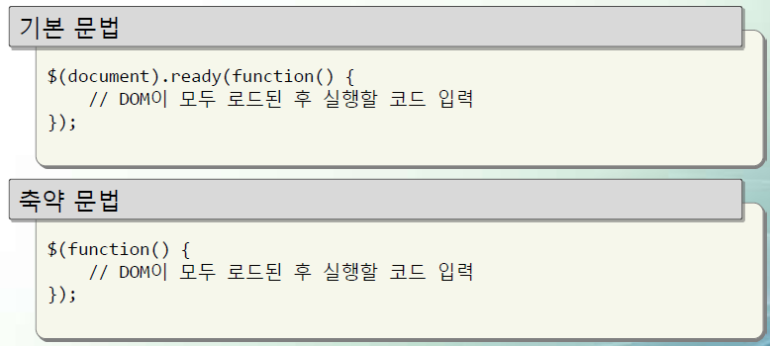
jQuery ready ()
window.onload = function(){}
HTML DOM loading 후 실행할 callback 함수
jQuery(function())
HTML DOM loading 후 images loading 전 실행할 callback 함수

Slide 22
ready handler
Script 는 DOM 요소가 준비될 때까지 실행을 기다린다.
window.onload 와 동일
이미지를 포함하여 모두 load 될 때까지 기다린다.
따라서 script 실행이 늦어진다.
ready handler 는 DOM tree 가 만들어질 때까지만 기다린다.
jQuery 는 개발자가 이러한 모든 작업에 대해 신경쓰지 않도록 한다.

Slide 23
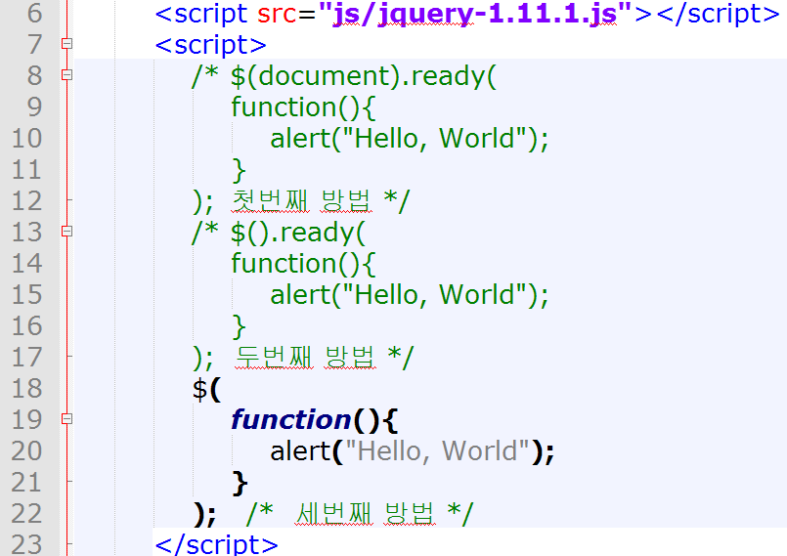
ready handler (Cont.)

Slide 24
$(expr, context)
Accepts a string containing a CSS or basic XPath selector.
The core functionality of jQuery.
Everything in jQuery is based upon this method.
Finds all matching elements.
By default, looks for DOM elements within the context of the current HTML document.

Slide 25
$(expr, context) (Cont.)
Parameters
expr : (String) : An expression to search with
context : (Element | jQuery) : (Optional) A DOM element, Document or jQuery to use as context
Returns
jQuery

Slide 26
$(expr, context) (Cont.)
Examples
$(“div > p”)
Finds all p elements that are children of a div element.
$(“input:radio”, document.forms[0])
Searches for all inputs of type radio within the first form in the document.
$(document.body).css(“background”, “black”)
Set the background color of the page to black.
See Also
$(element)

Slide 27
Lab : $(expr, context)
Web Browsers
IE11, Firefox, Google Chrome, Opera, Safari
Text Editors
Notepad++ or Editplus
Files
core.html

Slide 28
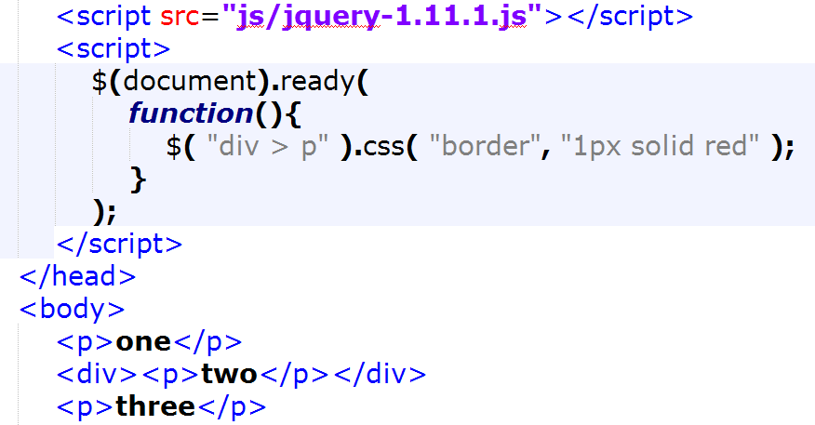
Lab : core.html

Slide 29
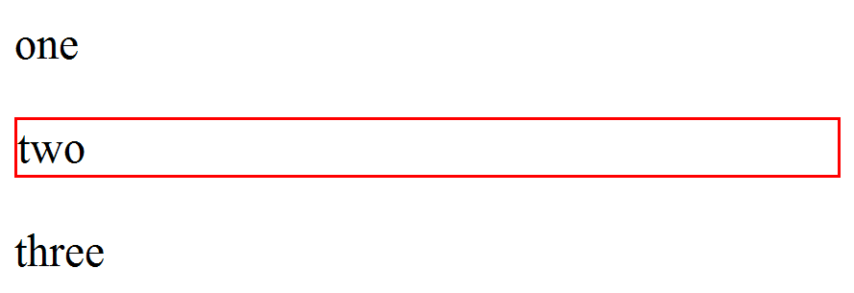
Lab : Result

Slide 30
$( html )
Create DOM elements on-the-fly from the provided String of raw HTML.
Parameters
html : (String) : A string of HTML to create on the fly.
Returns
jQuery
Example
$(“<div><p>Hello</p></div>”).appendTo(“#body”)
Creates a div element dynamically, and appends it to the element with the ID of body.

Slide 31
Lab : $( html )
Web Browsers
IE11, Firefox, Google Chrome, Opera, Safari
Text Editors
Notepad++ or Editplus
Files
Core_html.html

Slide 32
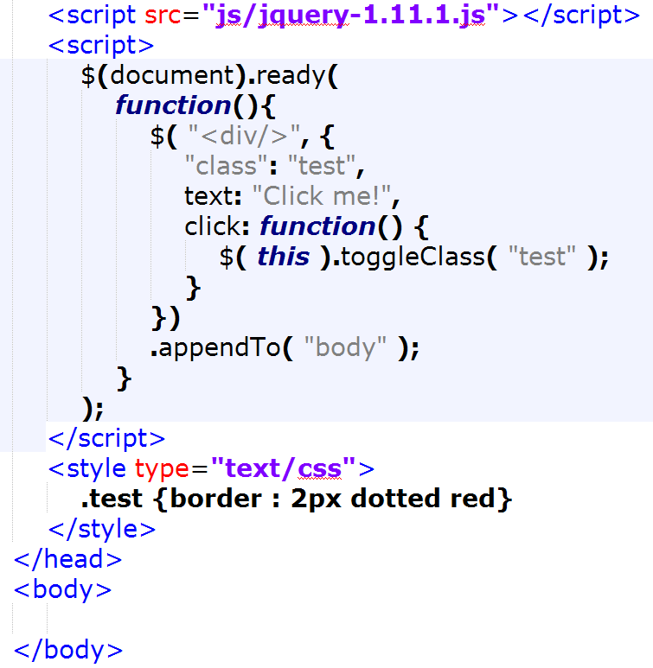
Lab : core_html.html

Slide 33
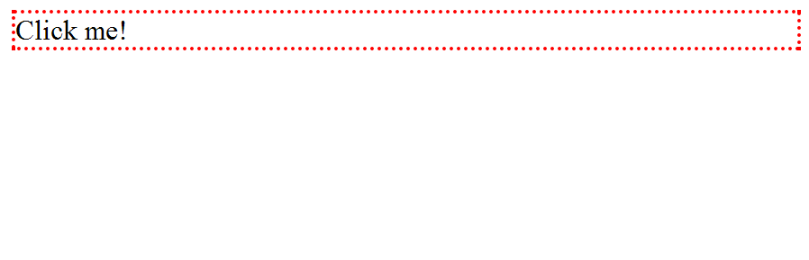
Lab : Result

Slide 34
$( elems )
Wrap jQuery functionality around a single or multiple DOM Element(s).
Parameters
elems : (Element | Array) : DOM element(s) to be encapsulated by a jQuery object.
Returns
jQuery

Slide 35
$( elems ) (Cont.)
Example
$(document).find(“div > p”)
Same as $(“div > p”).
$(document.body).background(“black”)
Sets the background color of the page to black.
$(myForm.elements).hide()
Hides all the input elements within a form.

Slide 36
$( fn )
A shorthand for $(document).ready()
Allows to bind a function to be executed when the DOM document has finished loading.
Parameters
fn : (Function) : The function to execute when the DOM is ready.
Returns
jQuery
Example
$(function(){ // Document is ready });

Slide 37
Lab : $( fn )
Web Browsers
IE11, Firefox, Google Chrome, Opera, Safari
Text Editors
Notepad++ or Editplus
Files
core_fn.html

Slide 38
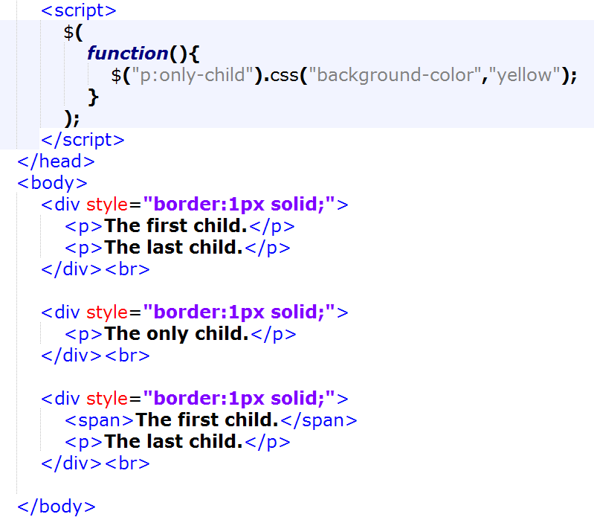
Lab : core_fn.html

Slide 39
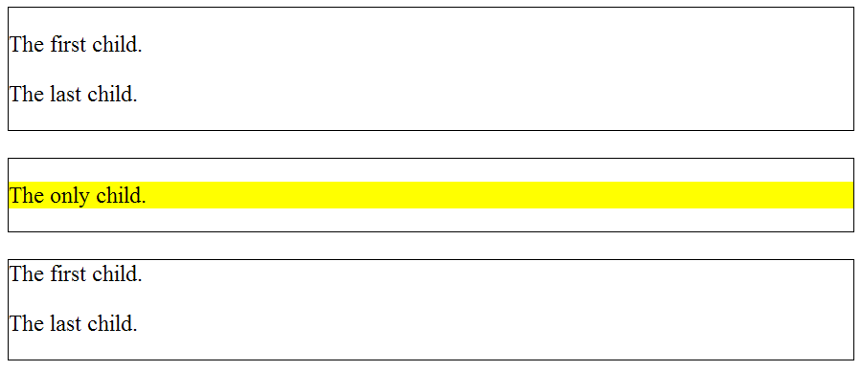
Lab : Result

Slide 40
$.holdReady()
Holds or releases the execution of jQuery’s ready event.
Returns
undefined
Example
$.holdReady( true );
$.getScript( "myplugin.js", function() {
$.holdReady( false );
});

Slide 41
Lab : $.holdReady()
Web Browsers
IE11, Firefox, Google Chrome, Opera, Safari
Text Editors
Notepad++ or Editplus
Files
core_holdready.html

Slide 42
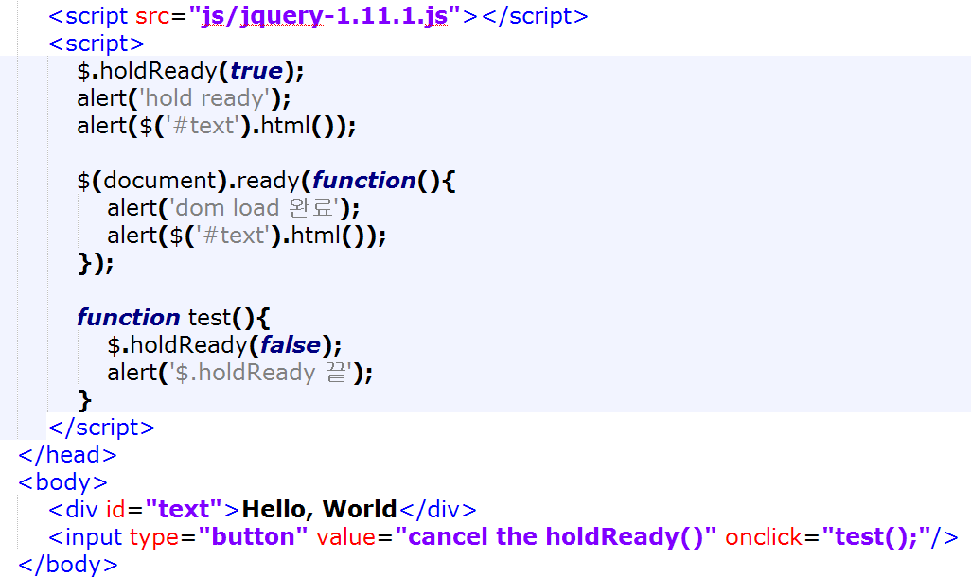
Lab : core_holdready.html

Slide 43
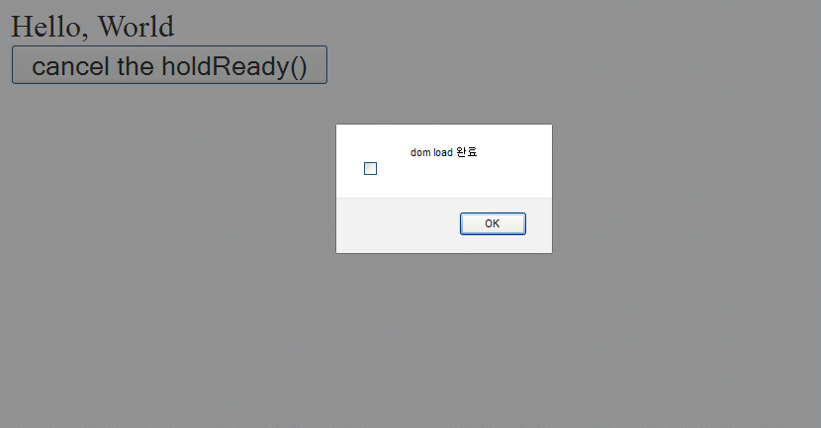
Lab : Result

Slide 44
$.noConflict()
Relinquish jQuery's control of the $ variable.
Returns
Object
Example
$.noConflict();

Slide 45
Lab : $.noConflict()
Web Browsers
IE11, Firefox, Google Chrome, Opera, Safari
Text Editors
Notepad++ or Editplus
Files
core_noconflict.html

Slide 46
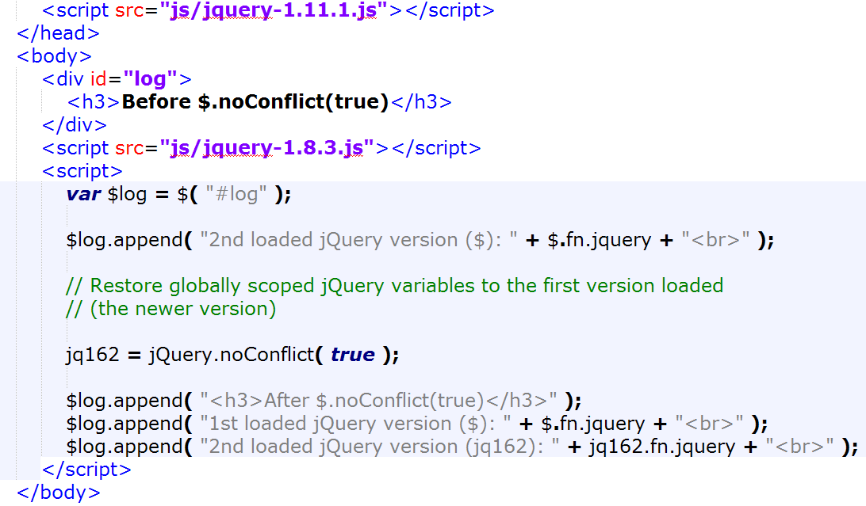
Lab : core_noconflict.html

Slide 47
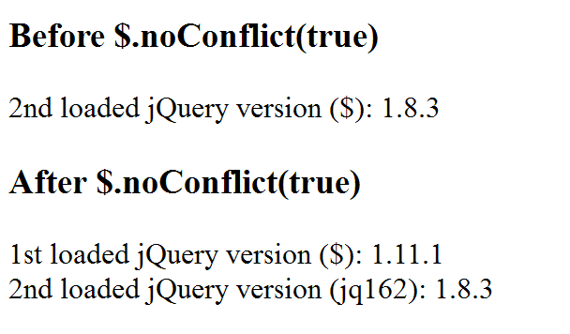
Lab : Result

Slide 48
Selectors

Slide 49
CSS Selectors
Pattern | Meaning | CSS Level
* | Any element | 2
E | An element of type E | 1
E[foo] | An E element with a “foo” attribute | 2
E[foo=“bar”] | An E element whose "foo" attribute value is exactly equal to "bar" | 2
E[foo~=“bar”] | An E element whose "foo" attribute value is a list of whitespace-separated values, one of which is exactly equal to "bar" | 2
E[foo^=“bar”] | An E element whose "foo" attribute value begins exactly with the string "bar" | 3
E[foo$=“bar”] | An E element whose "foo" attribute value ends exactly with the string "bar" | 3
E[foo*=“bar”] | An E element whose "foo" attribute value contains the substring "bar" | 3
E[foo|=“en”] | An E element whose "foo" attribute has a hyphen-separated list of values beginning (from the left) with "en" | 2

Slide 50
CSS Selectors (Cont.)
Pattern | Meaning | CSS Level
E:root | An E element, root of the document | 3
E:nth-child(n) | An E element, the n-th child of its parent | 3
E:nth-last-child(n) | An E element, the n-th child of its parent, counting from the last one | 3
E:nth-of-type(n) | An E element, the n-th sibling of its type | 3
E:nth-last-of-type(n) | An E element, the n-th sibling of its type, counting from the last one | 3
E:first-child | An E element, first child of its parent | 2
E:last-child | An E element, last child of its parent | 3
E:first-of-type | An E element, first sibling of its type | 3
E:last-of-type | An E element, last sibling of its type | 3
E:only-child | An E element, only child of its parent | 3
E:only-of-type | An E element, only sibling of its type | 3
E:empty | An E element that has no children (including text nodes) | 3

Slide 51
CSS Selectors (Cont.)
Pattern | Meaning | CSS Level
E:link | An E element being the source anchor of a hyperlink of which the target is not yet visited (:link) or already visited (:visited) | 1
E:visited
E:active | An E element during certain user actions | 1 and 2
E:hover
E:focus
E:target | An E element being the target of the referring URI | 3
E:lang(fr) | An element of type E in language "fr" (the document language specifies how language is determined) | 2
E:enabled | An user interface element E which is enabled or disabled | 3
E:disabled
E:checked | An user interface element E which is checked (for instance a radio-button or checkbox) | 3

Slide 52
CSS Selectors (Cont.)
Pattern | Meaning | CSS Level
E:first-line | The first formatted line of an E element | 1
E:first-letter | The first formatted letter of an E element | 1
E:before | Generated content before an E element | 2
E:after | Generated content after an E element | 2
E:warning | An E element whose class is "warning" (the document language specifies how class is determined). | 1
E#myid | An E element with ID equal to "myid". | 1
E:not(s) | An E element that does not match simple selector s | 3
E F | An F element descendant of an E element | 1
E > F | An F element child of an E element | 2
E + F | An F element immediately preceded by an E element | 2
E ~ F | An F element preceded by an E element | 3
http://www.w3.org/TR/css3-selectors/

Slide 53
Basic
CSS selector의 대부분을 지원한다.
All selector (“*”)
Class selector (“.class”)
Element selector (“element”)
ID selector (“#id”)
Multiple selector (“selector1, selector2, selectorN”)

Slide 54
Basic (Cont.)
단일 요소 선택
$(“p”) : 모든 <p> 요소 선택
$(‘a’) : 모든 <a> 요소 선택
➔ ‘’, “” 중 하나 사용
다중 요소 선택
$(‘p, span, a’) : 모든 <p>, <span>, <a> 요소 선택
➔ 다중 요소 선택 시 콤마(,) 사용으로 구분

Slide 55
Basic (Cont.)
ID가 지정된 요소는 # 기호로 선택
$(“#ID”)
HTML 은 하나의 페이지에 단 하나의 ID 요소만 가능
Class 가 지정된 요소는 . 기호로 선택
$(‘.className’)
➔ 한 번에 여러 개의 클래스 요소 선택 가능

Slide 56
Lab : Basic Selectors
Web Browsers
IE11, Firefox, Google Chrome, Opera, Safari
Text Editors
Notepad++ or Editplus
Files
selector.html

Slide 57
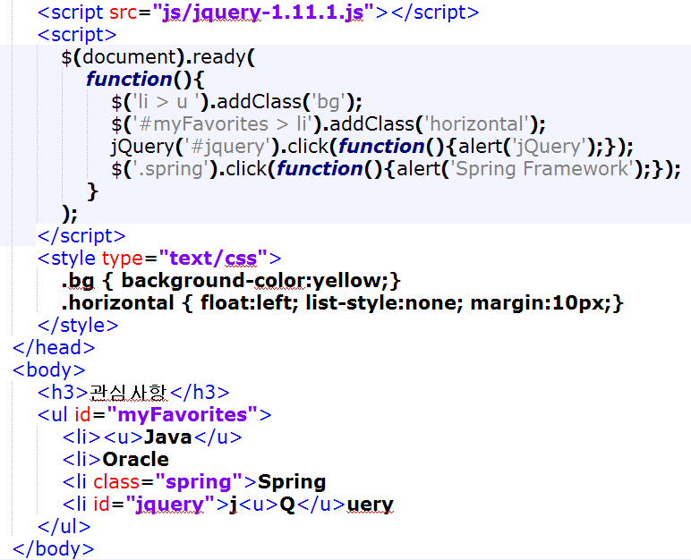
Lab : selector.html

Slide 58
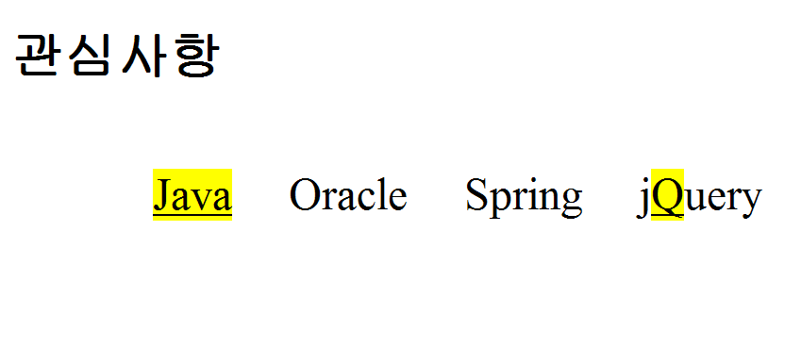
Lab : Result

Slide 59
Attribute
Has Attribute selector [name]
Equals selector [name=“value”]
Not equal selector [name!=“value”]
Starts with selector [name^=“value”]
Ends with selector [name$=“value”]
Multiple selector [name=“value”][name2=“value2”]
Contains selector [name*=“value”]
Contains prefix selector [name|=“value”]
Contains word selector [name~=“value”]

Slide 60
Lab : Attributes
Web Browsers
IE11, Firefox, Google Chrome, Opera, Safari
Text Editors
Notepad++ or Editplus
Files
selector1.html

Slide 61
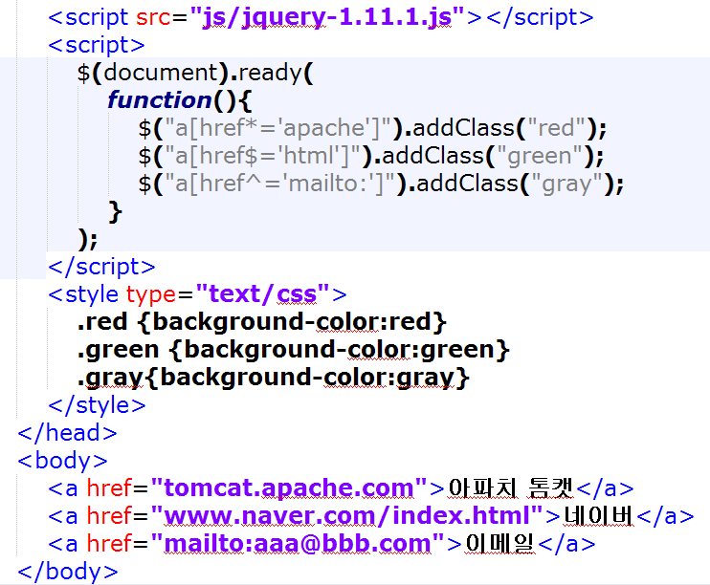
Lab : selector1.html

Slide 62
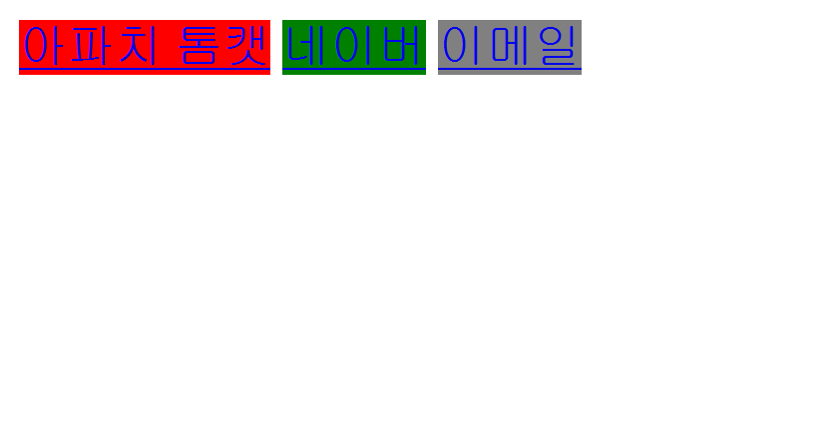
Lab : Result

Slide 63
Basic Filter
:first selector, :last selector
선택된 요소 중 처음, 마지막 요소 선택
:even selector, :odd selector
짝수, 홀수번째 요소 선택
:eq(n) selector
n번째 요소 선택

Slide 64
Lab : Even, Odd
Web Browsers
IE11, Firefox, Google Chrome, Opera, Safari
Text Editors
Notepad++ or Editplus
Files
EvenOdd.html

Slide 65
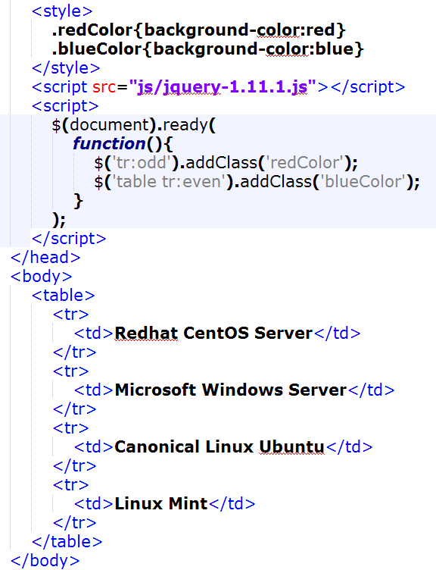
Lab : EvenOdd.html

Slide 66

Lab : Result

Slide 67
Basic Filter (Cont.)
:lt(n) selector, :gt(n) selector
n 보다 작은, n 보다 큰 요소 선택
:header selector
제목 요소 선택
:not() selector
선택자에 해당되지 않는 요소 선택
:animated selector
현재 움직이고 있는 요소 선택

Slide 68
Child Filter
:nth-child() selector
부모 요소의 n 번째 자식 요소 선택

Slide 69
Content Filter
:contains(str) selector
특정 텍스트를 포함하는 요소 선택
:empty selector
빈 요소 선택
:parent selector
자식이 있는 부모 요소 선택
:has() selector
Selector 에 해당하는 요소를 포함하고 있는 요소 선택

Slide 70
Lab : Contains
Web Browsers
IE11, Firefox, Google Chrome, Opera, Safari
Text Editors
Notepad++ or Editplus
Files
contains.html

Slide 71
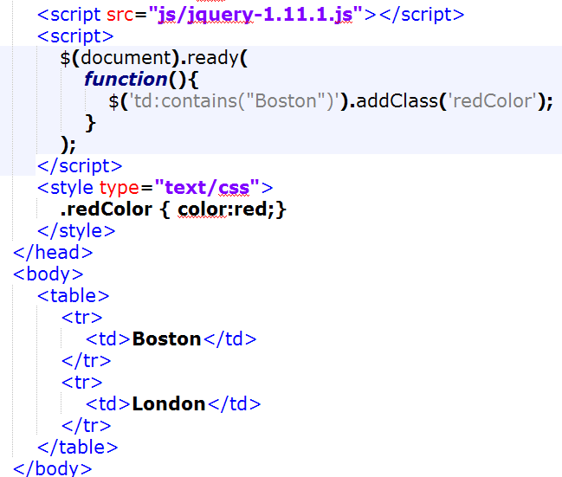
Lab : contains.html

Slide 72
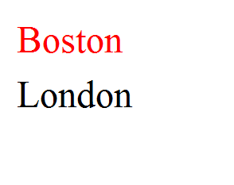
Lab : Result

Slide 73
Form
:input, :checkbox, :radio
:text, :password, :file
:button, :submit, :image, :reset
:focus
:checked
:selected
:enabled, :disabled

Slide 74
Lab : Input form
Web Browsers
IE11, Firefox, Google Chrome, Opera, Safari
Text Editors
Notepad++ or Editplus
Files
Input_form.html

Slide 75
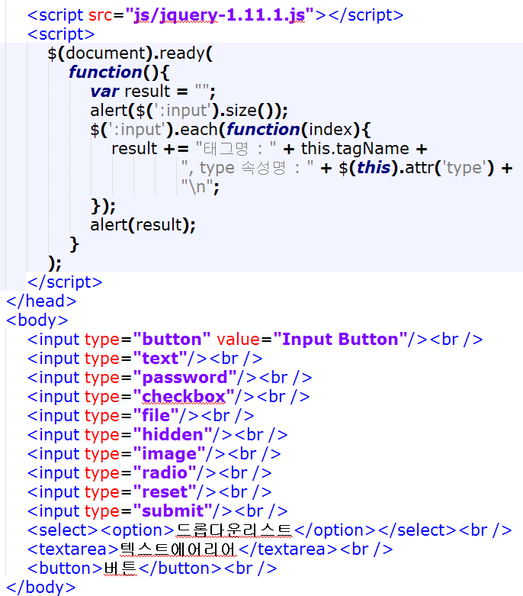
Lab : input_form.html

Slide 76
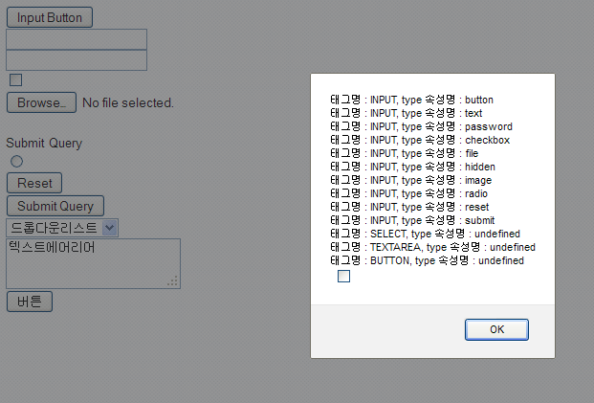
Lab : Result

Slide 77
Hierarchy
Child selector (“parent > child”)
부모의 자식 요소 선택
Descendant selector (“ancestor descendant”)
하위 요소를 모두 선택
Next Adjacent selector (“prev + next”)
prev 다음에 인접한 next 요소 선택
Next siblings selector (“prev ~ siblings”)
prev 이후에 나오는 형제 요소들을 선택

Slide 78
Visibility Filter
:visible selector
보이는 요소 선택
:hidden selector
보이지 않는 요소 선택

Slide 79
Attributes / CSS

Slide 80
.addClass( )
Adds the specified class(es) to each of the set of matched elements.
Parameters
class : (String) : A CSS class to add to the elements.
Returns
jQuery
Example
$(“p”).addClass(“selected”)

Slide 81
Lab : .addClass( )
Web Browsers
IE11, Firefox, Google Chrome, Opera, Safari
Text Editors
Notepad++ or Editplus
Files
addClass.html

Slide 82
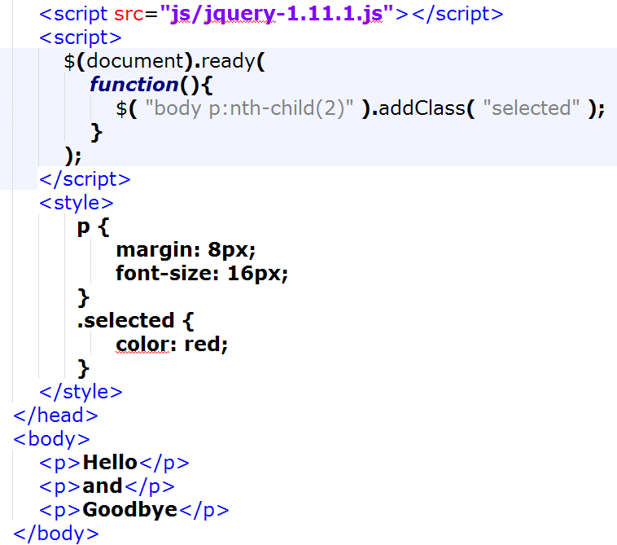
Lab : addClass.html

Slide 83
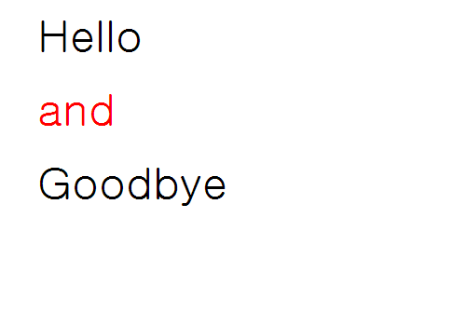
Lab : Result

Slide 84
Lab : .addClass( )
Web Browsers
IE11, Firefox, Google Chrome, Opera, Safari
Text Editors
Notepad++ or Editplus
Files
addClass1.html

Slide 85
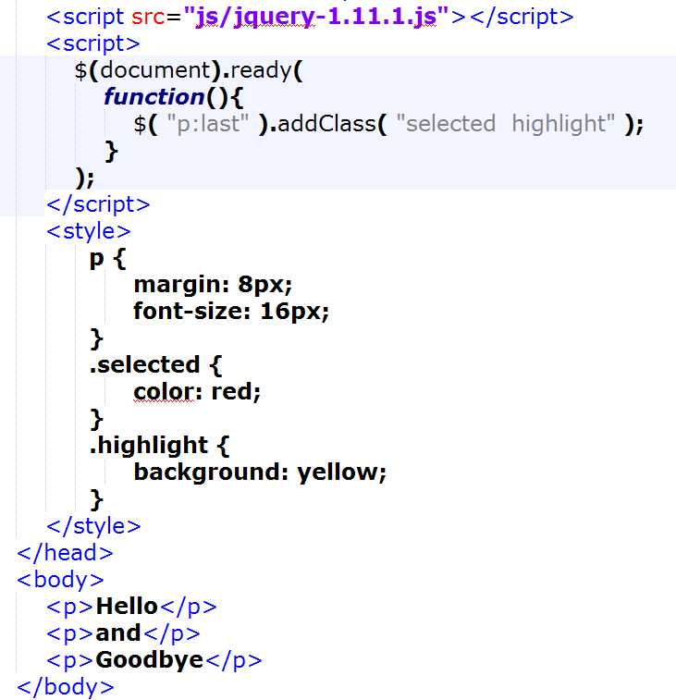
Lab : addClass1.html

Slide 86

Lab : Result

Slide 87
Lab : .addClass( )
Web Browsers
IE11, Firefox, Google Chrome, Opera, Safari
Text Editors
Notepad++ or Editplus
Files
addClass2.html

Slide 88
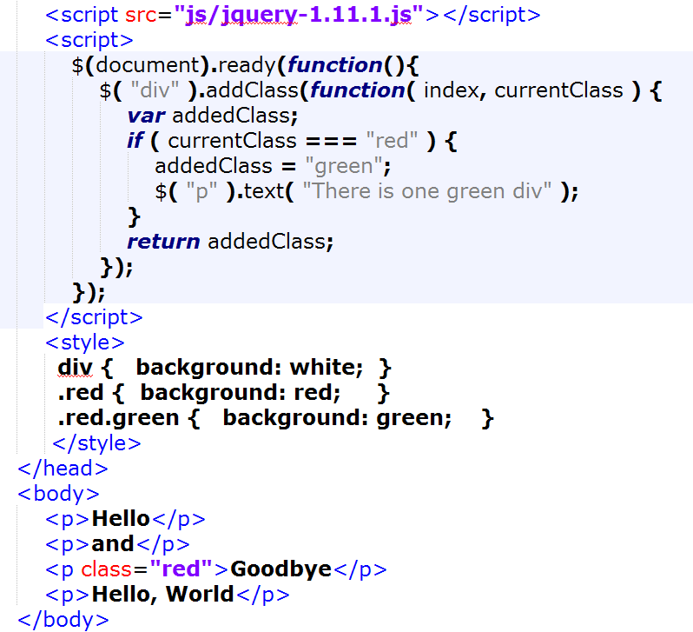
Lab : addClass2.html

Slide 89
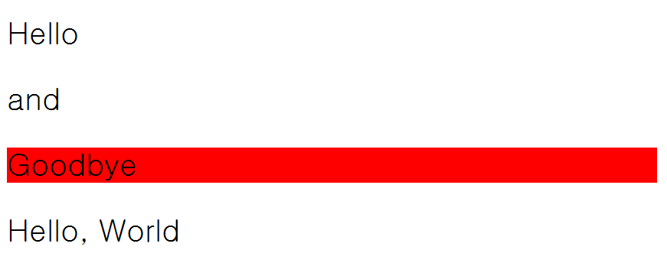
Lab : Result

Slide 90
.removeClass( )
Removes all or the specified class from the set of matched elements.
Parameters
class : (String) : (optional) A CSS to remove from the elements.
Returns
jQuery
Examples
$(“p”).removeClass()
$(“p”).removeClass(“selected”)

Slide 91
Lab : .removeClass( )
Web Browsers
IE11, Firefox, Google Chrome, Opera, Safari
Text Editors
Notepad++ or Editplus
Files
removeClass.html

Slide 92
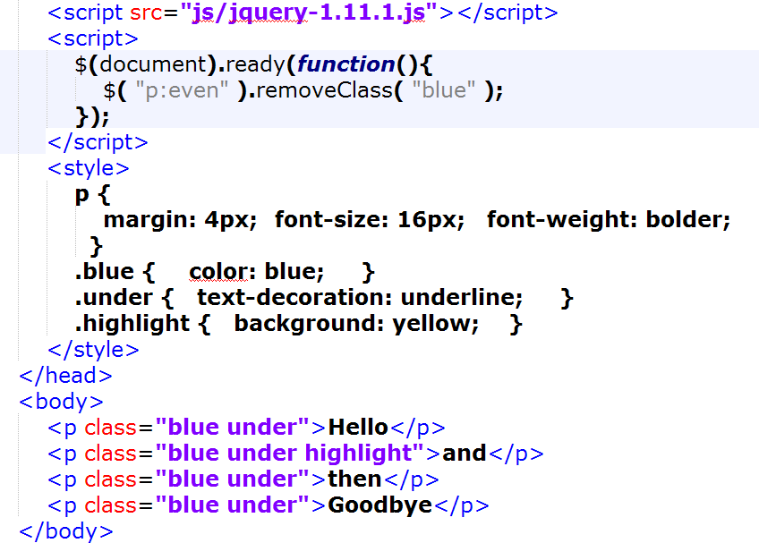
Lab : removeClass.html

Slide 93
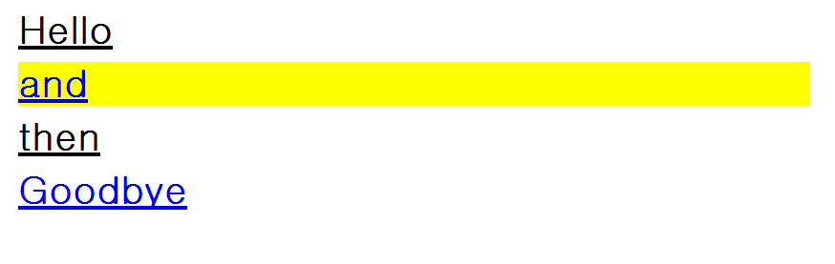
Lab : Result

Slide 94
.toggleClass( )
Adds the specified class if it is not present, removes it if it is present.
Parameters
class : (String) : A CSS class with which to toggle the elements.
Returns
jQuery
Examples
$(“p”).toggleClass(“selected”)

Slide 95
Lab : .toggleClass( )
Web Browsers
IE11, Firefox, Google Chrome, Opera, Safari
Text Editors
Notepad++ or Editplus
Files
toggleClass.html

Slide 96
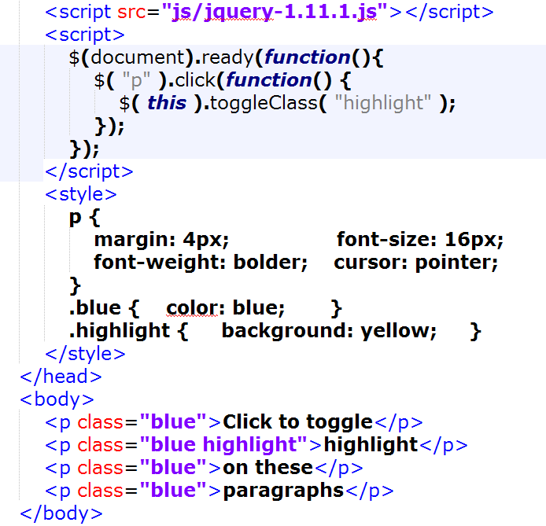
Lab : toggleClass.html

Slide 97
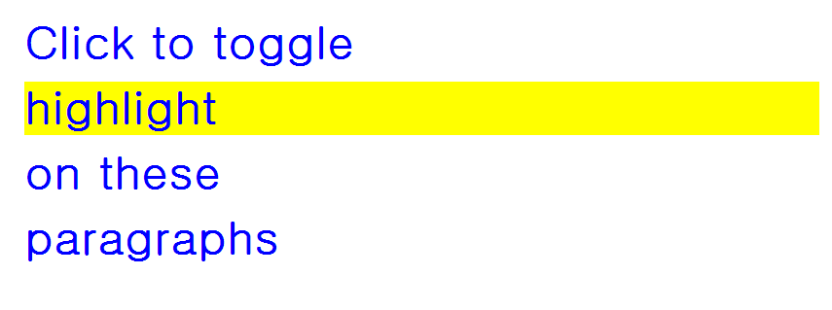
Lab : Result

Slide 98
.attr( )
Access a property on the first matched element.
Makes it easy to retrieve a property value from the first matched element.
Parameters
name : (String) : The name of the property to access.
Returns
Object
Examples
$(“img”).attr(“src”);

Slide 99
.attr( )
Set a key/value object as properties to all matched elements.
Serves as the best way to set a large number of properties on all matched elements.
Parameters
properties : (Map) : Key/value pairs to set as object properties.
Returns
jQuery
Examples
$(“img”).attr({src:”test.jpg”, alt:”Test Image”});

Slide 100
.attr( )
Set a single property to a value, on all matched elements.
Parameters
key : (String) : The name of the property to set.
value : (Object) : The value to set the property to.
Returns
jQuery
Examples
$(“img”).attr(“src”, “test.jpg”);

Slide 101
Lab : .attr( )
Web Browsers
IE11, Firefox, Google Chrome, Opera, Safari
Text Editors
Notepad++ or Editplus
Files
attr.html

Slide 102
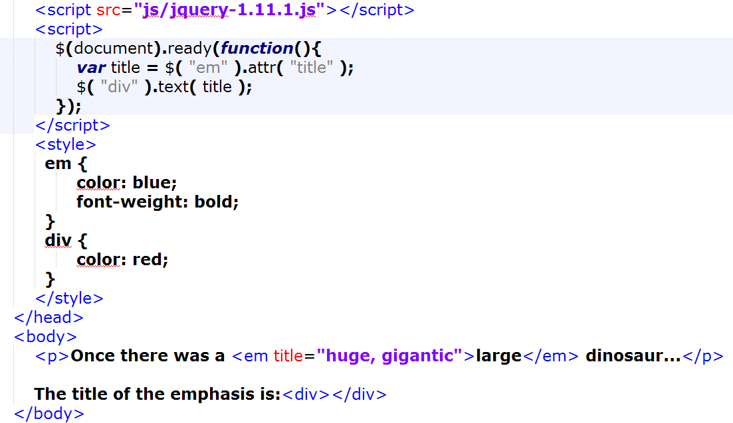
Lab : attr.html

Slide 103
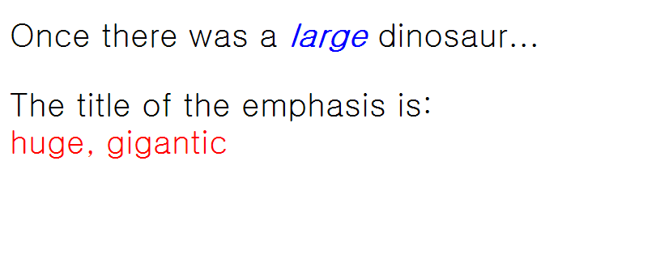
Lab : Result

Slide 104
Lab : .attr( )
Web Browsers
IE11, Firefox, Google Chrome, Opera, Safari
Text Editors
Notepad++ or Editplus
Files
attr1.html

Slide 105
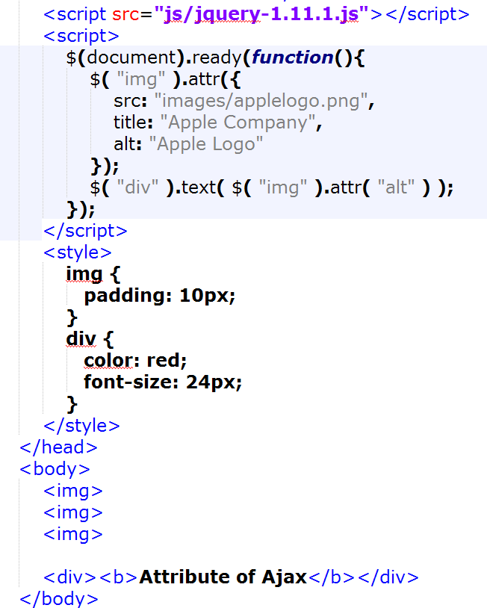
Lab : attr1.html

Slide 106

Lab : Result

Slide 107
.removeAttr( )
Remove an attribute from each of the matched elements.
Parameters
name : (String) : The name of the attribute to remove.
Returns
jQuery
Examples
$(“input”).removeAttr(“disabled”);

Slide 108
Lab : .removeAttr( )
Web Browsers
IE11, Firefox, Google Chrome, Opera, Safari
Text Editors
Notepad++ or Editplus
Files
removeAttr.html

Slide 109
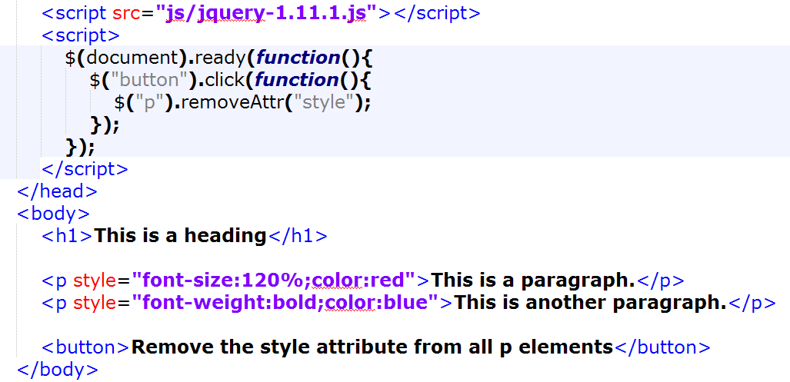
Lab : removeAttr.html

Slide 110
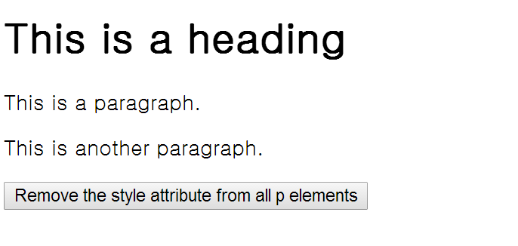
Lab : Result

Slide 111
.hasClass( )
Checks if any of the selected elements have a specified class name.
If ANY of the selected elements has the specified class name, this method will return "true".
Parameters
classname : (String) : The name of the class to test.
Returns
Boolean
Examples
$(“p”).hasClass(“title”);

Slide 112
Lab : .hasClass( )
Web Browsers
IE11, Firefox, Google Chrome, Opera, Safari
Text Editors
Notepad++ or Editplus
Files
hasClass.html

Slide 113
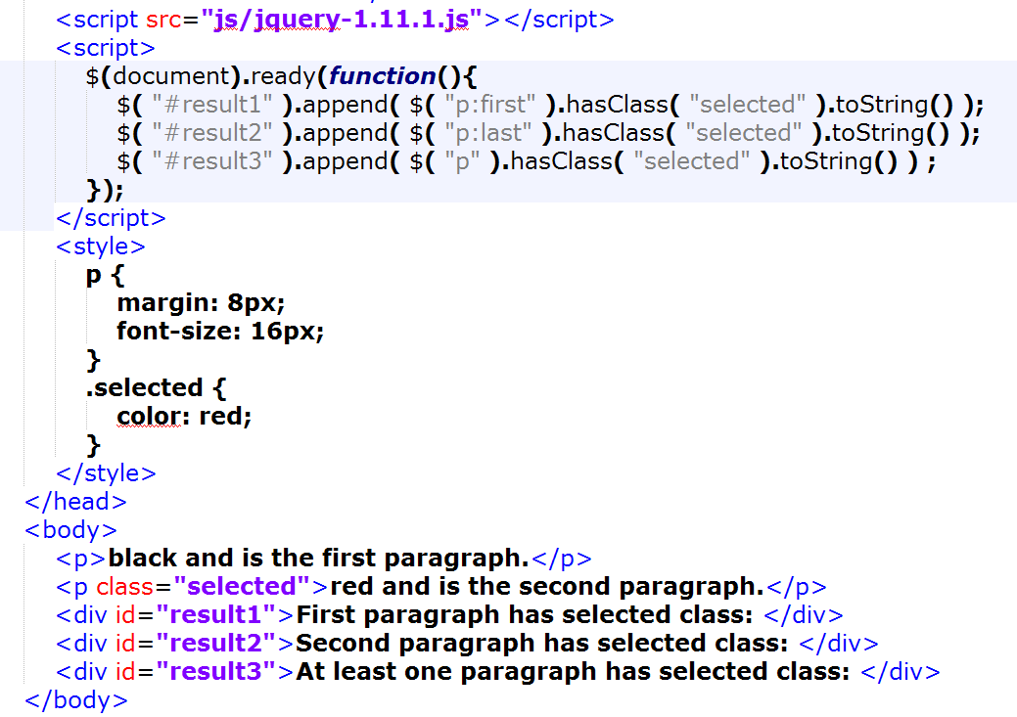
Lab : hasClass.html

Slide 114
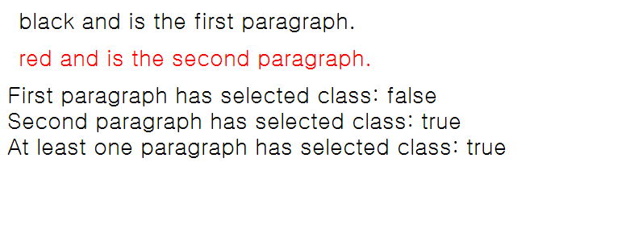
Lab : Result

Slide 115
.html( )
Get the html contents of the first matched element.
Returns
String
Examples
$(“div”).html();

Slide 116
.html( )
Set the html contents of every matched element.
Parameters
val : (String) : Set the html contents to the specified value.
Returns
jQuery
Examples
$(“div”).html(“<b>new stuff</b>”);

Slide 117
Lab : .html( )
Web Browsers
IE11, Firefox, Google Chrome, Opera, Safari
Text Editors
Notepad++ or Editplus
Files
css_html.html

Slide 118
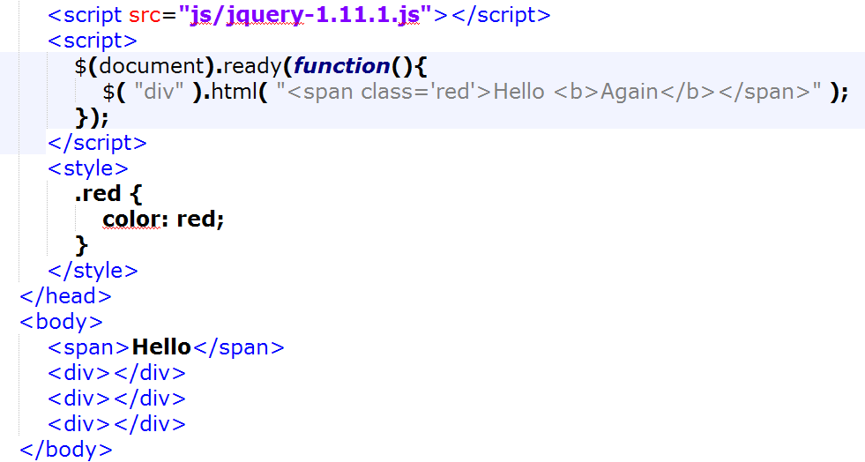
Lab : css_html.html

Slide 119

Lab : Result

Slide 120
.prop( )
Get the value of a property for the first element in the set of matched elements or set one or more properties for every matched element.
Parameters
propertyName : (String) : The name of the property to get.
Returns
Anything
Examples
$(“em”).prop(“checked”);

Slide 121
Lab : .prop( )
Web Browsers
IE11, Firefox, Google Chrome, Opera, Safari
Text Editors
Notepad++ or Editplus
Files
prop.html

Slide 122
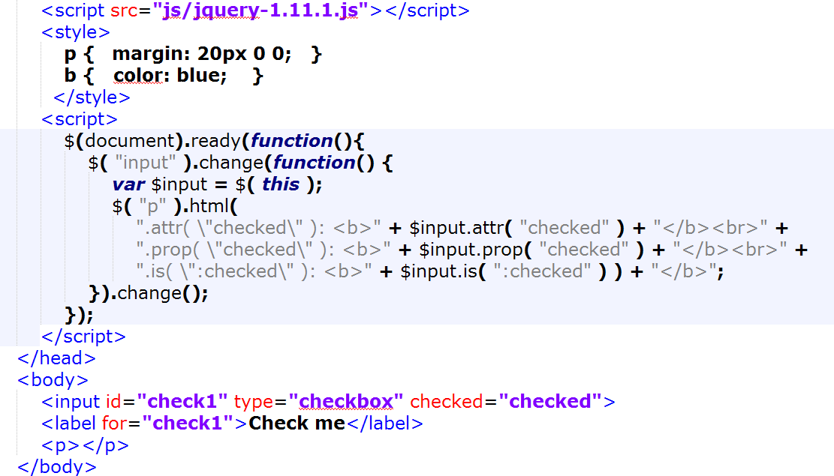
Lab : prop.html

Slide 123
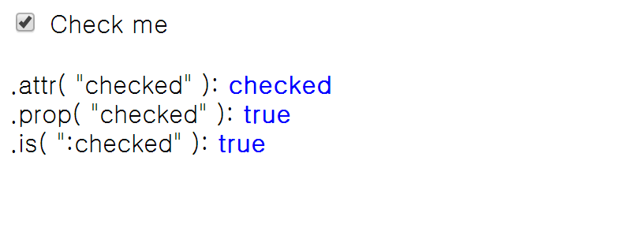
Lab : Result

Slide 124
.prop( ) (Cont.)
Set one or more properties for the set of matched elements.
Parameters
propertyName : (String) : The name of the property to get.
value : (Anything) : A value to set for the property.
Returns
jQuery
Examples
$(“input”).prop(“checked”, true);

Slide 125
Lab : .prop( )
Web Browsers
IE11, Firefox, Google Chrome, Opera, Safari
Text Editors
Notepad++ or Editplus
Files
prop1.html

Slide 126
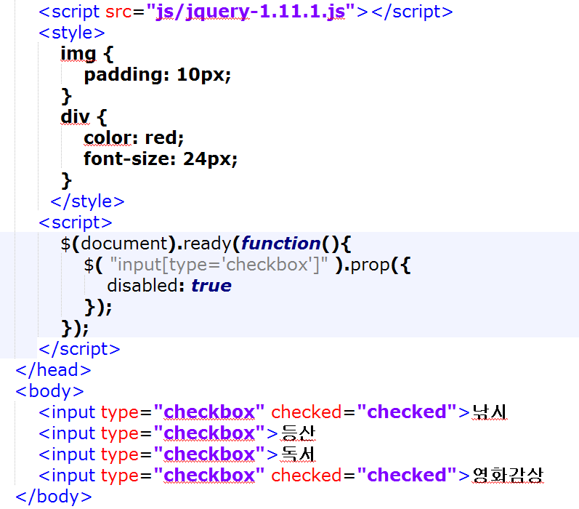
Lab : prop1.html

Slide 127

Lab : Result

Slide 128
.removeProp( )
Remove a property for the set of matched elements.
Parameters
propertyName : (String) : The name of the property to remove.
Returns
jQuery
Examples
$(“p”).removeProp(“checked”);

Slide 129
Lab : .removeProp( )
Web Browsers
IE11, Firefox, Google Chrome, Opera, Safari
Text Editors
Notepad++ or Editplus
Files
removeProp.html

Slide 130
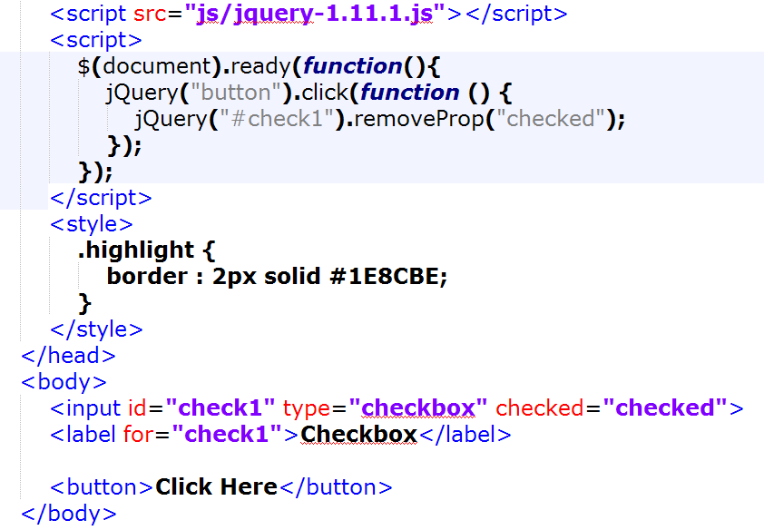
Lab : removeProp.html

Slide 131

Lab : Result

Slide 132
.val( )
Get the current value of the first matched element.
Returns
String
Examples
$(“input”).val();

Slide 133
.val( ) (Cont.)
Set the value of every matched element.
Parameters
value : (String) : Set the property to the specified value.
Returns
jQuery
Examples
$(“input”).val(“test”);

Slide 134
Lab : .val( )
Web Browsers
IE11, Firefox, Google Chrome, Opera, Safari
Text Editors
Notepad++ or Editplus
Files
val.html

Slide 135
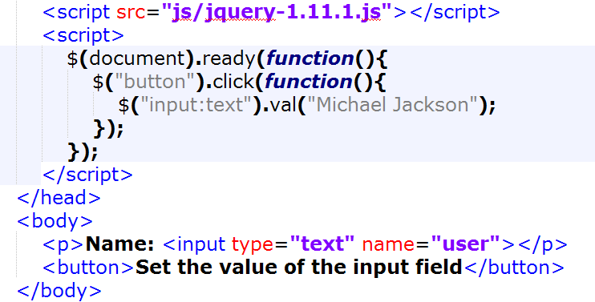
Lab : val.html

Slide 136

Lab : Result

Slide 137
.text( )
Get the text contents of all matched elements.
Returns
String
Examples
$(“p”).text();

Slide 138
.text( ) (Cont.)
Set the text contents of all matched elements.
This has the same effect as html().
Parameters
value : (String) : The text value to set the contents of the element to.
Returns
String
Examples
$(“input”).text(“Some new text.”);

Slide 139
Lab : .text( )
Web Browsers
IE11, Firefox, Google Chrome, Opera, Safari
Text Editors
Notepad++ or Editplus
Files
text.html

Slide 140

Lab : text.html

Slide 141

Lab : Result

Slide 142
.css( )
Access a style property on the first matched element.
Makes it easy to retrieve a style property value from the first matched element. .
Returns
String
Examples
$(“p”).css(“color”);

Slide 143
.css( ) (Cont.)
Set a key/value object as style properties to all matched elements.
Parameters
properties : (Map) : Key/value pairs to set as style properties.
Returns
jQuery
Examples
$(“p”).css({color:”red”, background:”blue”});

Slide 144
.css( ) (Cont.)
Set a single style property to a value, on all matched elements.
Parameters
key : (String) : The name of the property to set.
value : (Object) : The value to set the property to.
Returns
jQuery
Examples
$(“p”).css(“color”, “red”);

Slide 145
Lab : .css( )
Web Browsers
IE11, Firefox, Google Chrome, Opera, Safari
Text Editors
Notepad++ or Editplus
Files
css.html

Slide 146

Lab : css.html

Slide 147

Lab : Result

Slide 148
Lab : .css( )
Web Browsers
IE11, Firefox, Google Chrome, Opera, Safari
Text Editors
Notepad++ or Editplus
Files
css1.html

Slide 149

Lab : css1.html

Slide 150

Lab : Result

Slide 151
.height( )
Returns the css height value for the first matched element.
If used on document, returns the document's height (innerHeight).
If used on window, returns the viewport's (window) height.
Returns
Number
Examples
$(document).height();

Slide 152
.width( )
Returns the css width value for the first matched element.
If used on document, returns the document's width (innerWidth).
If used on window, returns the viewport's (window) width.
Returns
Number
Examples
$(document).width();

Slide 153
.innerHeight( )
Returns the inner height value (without border) for the first matched element.
If used on document, returns the document's height (innerHeight).
If used on window, returns the viewport's (window) height.
Returns
Number
Examples
$(“#testdiv).innerHeight();

Slide 154
.innerWidth( )
Returns the inner width value (without border) for the first matched element.
If used on document, returns the document's Width (innerWidth).
If used on window, returns the viewport's (window) width.
Returns
Number
Examples
$(“#testdiv”).innerWidth();

Slide 155
.outerHeight( )
Returns the outer height value (including border) for the first matched element.
Cannot be used on document or window.
Returns
Number
Examples
$(“#testdiv”).outerHeight();

Slide 156
.outerWidth( )
Returns the outer width value (including border) for the first matched element.
Cannot be used on document or window.
Returns
Number
Examples
$(“#testdiv”).outerWidth();

Slide 157
.scrollLeft( )
Returns how many pixels the user has scrolled to the right (scrollLeft).
Works on containers with overflow: auto and window/document.
Returns
Number
Examples
$(“#testdiv”).scrollLeft();

Slide 158
.scrollTop( )
Returns how many pixels the user has scrolled to the bottom (scrollTop).
Works on containers with overflow: auto and window/document.
Returns
Number
Examples
$(“#testdiv”).scrollTop();

Slide 159
.offset( )
Access a style property on the first matched element.
Makes it easy to retrieve a style property value from the first matched element. .
Returns
String
Examples
$(“p”).css(“color”);

Slide 160
.offset( )
Access a style property on the first matched element.
Makes it easy to retrieve a style property value from the first matched element. .
Returns
String
Examples
$(“p”).css(“color”);

